Slide 1
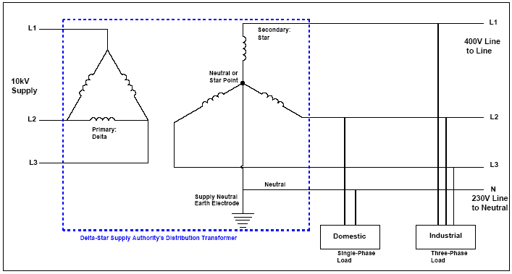
3-phase Supply
Division or balancing of Loads
  Balanced phases
  Transformer Sizing implications
  Cable sizing implications
  Neutral Current implication
Advantages of a 3-Phase System:
  Dual Voltage
  Machine physicality's
  Rotational Magnetic Fluxes in Machines
  Transmission implications

Slide 2
Distribution Boards
A Distribution Board is described in the ETCI Rules for Electrical Installations (ET101: 2000) as an assembly of protective devices, including two or more fuses or circuit breakers, arranged for the distribution of electrical energy to final circuits or to other distribution boards.
A distribution board will consist of a suitable enclosure containing suitable facilities for mounting fuses and/or circuit breakers and other protective devices (such as residual current circuit breakers/devices which may, or may not, provide integral overcurrent protection) and other switching and control devices. A distribution board will also contain ‘busbars’ for interconnecting the circuit breakers or fuses along with neutral and earth bars for connecting the incoming and outgoing neutral conductors and protective conductors. This enclosure may be either of metal clad or all insulated type of construction.

Slide 3
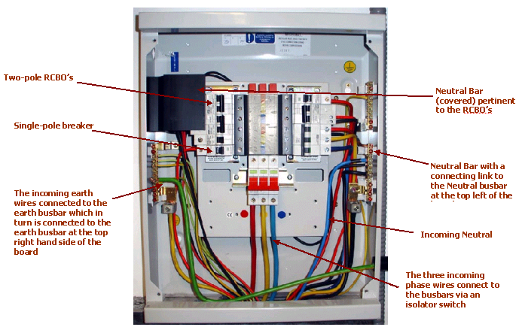
Distribution Boards
The diagram above illustrates a typical 12-position UK distribution panel. It is likely that the manufacturer produces 18 and 24-position versions of this panel using the same chasis which explains why there appears to be so much unused space.

Slide 4
Distribution Boards
Protection/ Location of Distribution Boards
    [ET 101: 2000: 538.1, I.S. EN60439]
  Shall be protected against dust, moisture, corrosive or polluting substances, excessive temperatures, impact, vibration and other mechanical stresses.
  Shall be readily accessible and not located over cooking or heating appliances, in bathrooms, washrooms or WC’s, in storage or airing cupboards, under staircases or where it might be covered by garments.
  Shall not be located in an escape route such as a stairway or corridor unless supplementary fire precaution measures are provided. This does not apply to single occupancy buildings.
  Shall not be located above or below, or within 400mm horizontally from a gas meter or a gas appliance in the same space.
  Shall be protected against damage arising from a fault in other services achieved by the use of barriers or by separation.
The Ingress Protection (IP) rating scheme is an internationally recognised system of denoting the degree of protection afforded by various products against
  Access to hazardous parts and
  Harmful ingress of water.

Slide 5
Distribution Boards
Connections
    [ET 101: 2000: 538.1, I.S. EN60439]
  The phase conductors of each two or three phase circuit shall be connected to the same way in a multi-way distribution board.
    1st Phase ‘Brown’ [must be brown]
    2nd Phase ‘Black’
    3rd Phase ‘Grey’
  Neutral and protective conductors shall be arranged in the same sequence as the corresponding phase conductors.
Identification & Marking:
    [ET 101: 2000: 514-4 & 515-1-2]
  Protective devices shall be arranged and identified so that the circuits protected may be easily recognised (this being facilitated by labels or other suitable means of identification – no possibility of confusion).
  Record sheets including diagrams and tables shall be available indicating:
    types of wiring
    size of conductors
    rating of protective devices
    points supplied
    information identifying protection, isolation and switching devices and their locations.
  Graphical symbols used shall comply with IEC Publication 60617 (Annex 51B ETCI)
  A distribution board not provided with a back plate shall not be mounted directly on a combustible surface. A separating material with a flammability rating of FH1 shall be used. These include:
    plaster board complying with the appropriate standard
    hardwood such as teak, oak, elm and mahogany.
    If the mounting surface is of metal it shall be bonded to the protective conductor or to the bonding conductor of the installation.

Slide 6
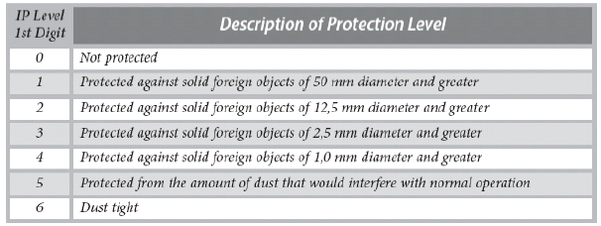
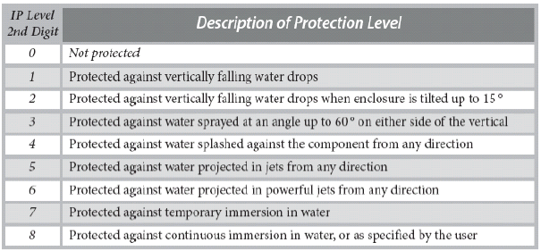
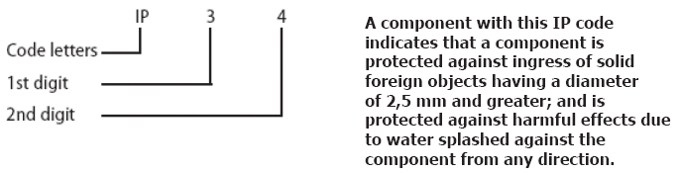
Ingress Protection

Slide 7
Overcurrents – ET101:2000
Overload:
    An overload current is where too much current is drawn down an electrically healthy circuit e.g. too many appliances are plugged in; there is no fault in the circuit. A properly designed circuit will interrupt an overload before any damage is done to the circuit.
Short Circuits
    This is where a fault of negligible impedance (resistance) occurs between live conductors. The value of current, which will flow, will depend on where the fault occurs. Longer runs of cable, particularly smaller cables have a significant attenuating effect on fault current.

Slide 8
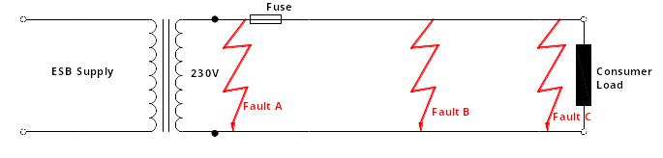
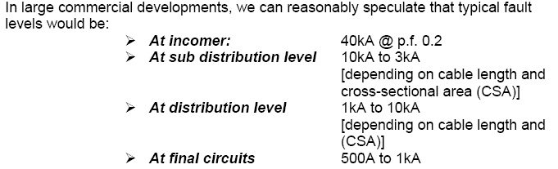
Overcurrents
The fault level, sometimes known as the prospective short circuit (I_{k}) is a significant factor when selecting protective devices – particularly circuit breakers.
The short circuit current at a particular point in an installation is dependent upon:
  The circuit voltage
  The total impedance of the circuit including the supply transformer

Slide 9
Overcurrents
Breaking Capacity :
  The purpose of determining the short circuit current at a point in an installation is to determine the Breaking Capacity in kA of the protective device situated at that point
Energy let through in the event of a short circuit is described in terms of:
  Pre-arcing Energy:
    Energy required to melt the fuse element
  Arcing Energy
    Energy required (post pre-arcing energy) to extinguish the resulting arc

Slide 10
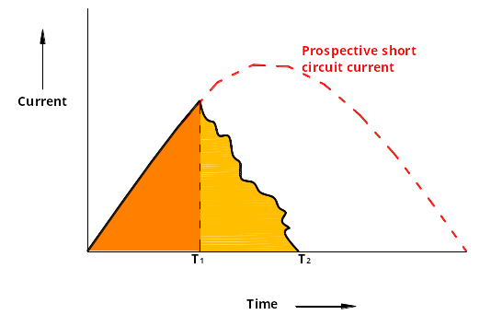
Overcurrents
The total let through energy is proportional to the energy dissipation during the pre-arcing and arcing intervals and is referred to as the I²t characteristic of the fuse/protective device.

Slide 11
Fuses
Types of Fuses:
  VDE 0635 DZ type fuse:
    This is a cartridge type fuse available in four body sizes D1, D11, D111 and DIV
    Current ratings from 2 Amps up to 100 Amps.
    The D1 size is no longer acceptable in this country but may still be found in very old installations.
    Breaking capacity up to 60kA.
  VDE 0636 NEOZED or DO type fuse:
    This is also a cartridge type fuse available in three body sizes D01, D02 and D03
    Current ratings from 2 up to 100Amps.
    Breaking capacity up to 50kA.
  VDE 0636 NH type fuse:
    Breaking capacity of 120kA.
    They are not designed for replacement by unqualified personnel
    They are available in ratings up to 1250Amps.
  BS 1361 fuse:
    This is a cartridge fuse available in ratings from 5 to 60 Amps.
    They are most commonly used in domestic and similar installations and in supply authority cut-outs.
    They have a breaking capacity of r16.5kA which is adequate for most domestic installation.

Slide 12
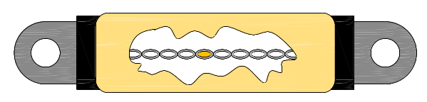
High Rupturing Capacity (HRC) Fuses
Reduced cross sections
Silver Element
End cap
Ceramic Body
Overload zone in the element – precise amount of metal with a low boiling point (usually tin). Here the metallurgical phenomenon known as the M-effect is utilised
Quartz filler
Fixing Lug
The BS88 HRC fuse consists of a specially shaped silver element totally enclosed in a heat proof body which is filled with very fine grains of quartz. The quartz holds the element in place - even while melting - ensures rapid arc extinction. The element is connected to two tinned brass end caps incorporating fixing lugs as shown above

Slide 13
Advantages of HRC Fuses
  Operation is very rapid
  Capable of breaking very high fault currents safely
  Declared current rating is very accurate
  Element does not weaken with age
  Capable of discriminating between a persistent fault and a transient fault such as the starting of a large inductive motor
  Different ratings are made to different physical sizes hence they are difficult to interchange

Slide 14
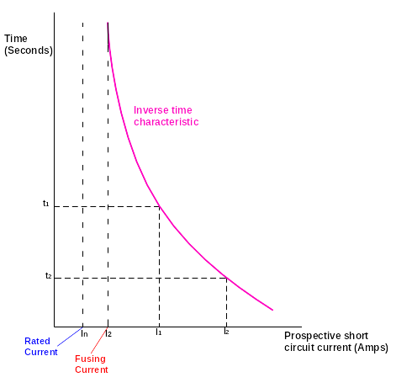
Fuse Characteristics
For a fuse to satisfactorily protect a cable, its characteristic must match, as closely as possible, the heating characteristic of the cable.
This means that fuses have an inverse time characteristic, i.e. the larger the over current, the faster the blowing time of the fuse.
Fuse characteristics are drawn on log/log scale as this enables a wide range of currents along with a wide range of time intervals to be charted

Slide 15
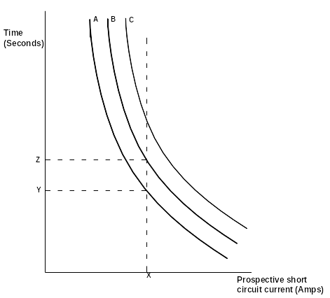
Fuse Characteristics: Discrimination
Discrimination:
  In a correctly designed installation, in the event of a fault, the fuse nearest to the fault should interrupt the circuit before any other device has a chance of interrupting it. This is known as discrimination.

Slide 16
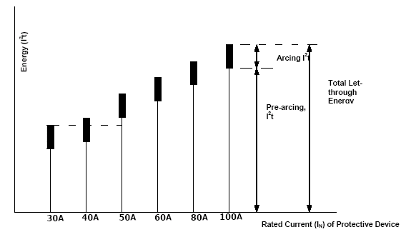
Fuse Characteristics: Discrimination
As Fuse characteristics will have tolerances associated with their manufacture, it is not possible to rely on Inverse time/current characteristics to design for discrimination.
It is necessary to use I²t characteristics

Slide 17
Circuit Breakers
Circuit breakers are divided into three main types:
    Miniature Circuit Breakers (MCB’s)
    Moulded Case Circuit Breakers(MCCB’s)
    Air Circuit Breakers (ACB’s)
From Supply Transformer to Final Circuits, i.e. decreasing breaking capacity

Slide 18
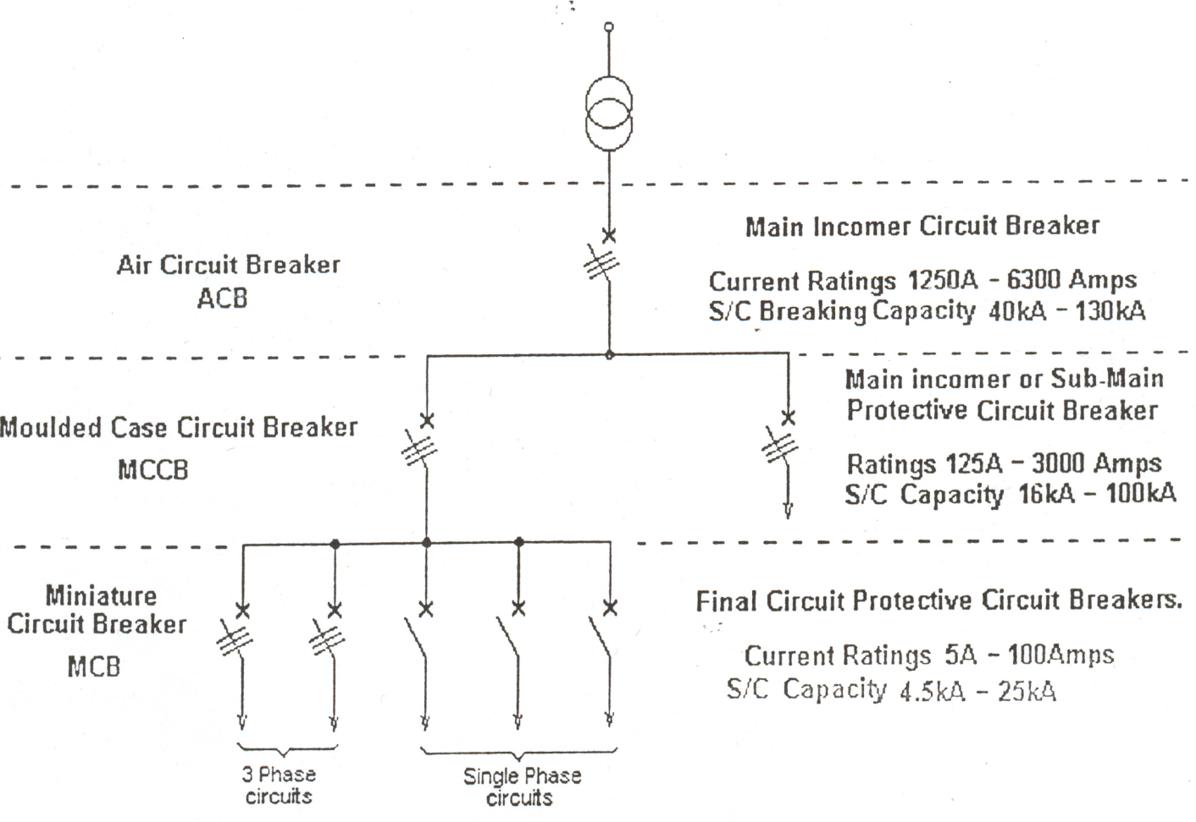
Circuit Breakers
10kV Supply
Single line diagram illustrating the sequence in which CBs are employed
Notes:
Air Circuit Breakers
ACB’s are mainly used on the incoming service cable feeding medium / large electrical installations. Because of their high current ratings (1250Amps to 6300Amps) and high short circuit breaking capacities (40A up to about 130kA) they are housed in metal enclosures which provides added strength and better cooling properties.
Moulded Case CBs
MCCBs are housed in a high impact plastic moulded casing having a very high electric insulating strength and designed to withstand the high stresses of fault currents. They have a smaller physical size than Air Circuit Breakers and are used to protect entire installations or parts of installations against both short circuit and normal overload currents.
They are available in current ratings from 125Amps up to 3000Amps with short circuit breaking capacities from 16kA up to about 100kA in different frame sizes. However their initial cost is high compared to switchgear incorporating HBC fuses
MCBs
MCB’s are available with current ratings from 5A up to 100A (125A are also available from some manufacturers) and with breaking capacities from 6kA up to 25kA at 230/380V depending on size. They are available in single, double, triple and four pole form.

Slide 19
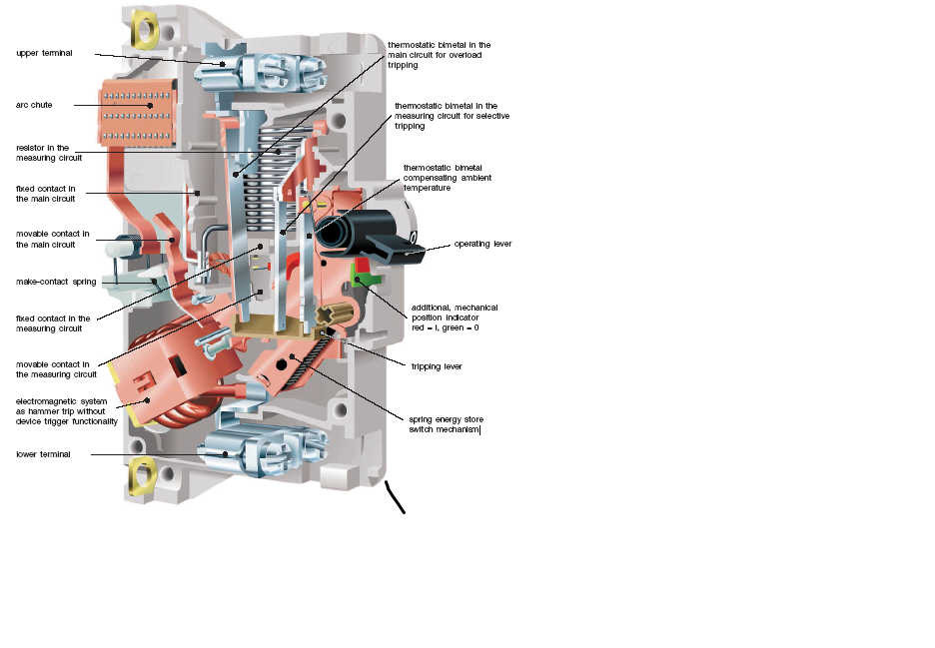
Miniature Circuit Breakers (MCB’s)

Slide 20
Miniature Circuit Breakers (MCB’s)
Categories of MCB’s:
  MCB’s manufactured to IS/EN 60898 (IEC 689) are of three types; B,C, D.
  MCB’s manufactured to IS/EN 60898 (VDE 0641) are of two types; L and G
MCB Overcurrent detection:
  Thermal Tripping
  Magnetic Tripping

Slide 21
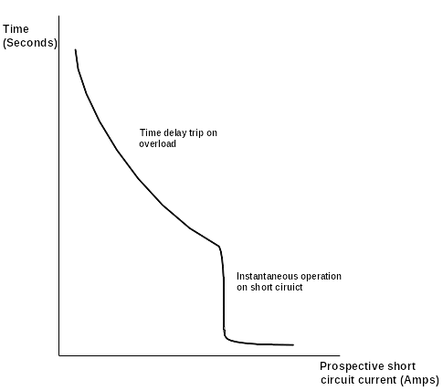
MCB Characteristics
Thermal tripping:
  In this type of tripping mechanism the current is passed through a bimetal strip connected in series with a magnetic coil.
Magnetic tripping:
  When a short circuit occurs, the heavy current in the magnetic coil produces a strong magnetic field which instantly opens the breaker
Arc Extinction:
  facilitated by guiding the arc (via self-induced magnetic fields) on splitter plates
  facilitated by guiding the arc (via self-induced magnetic fields) on splitter plates (as illustrated in figure 7). The V-shaped metal splitter plates increase the length of the arc, splits it up, cools it and d-ionises it

Slide 22
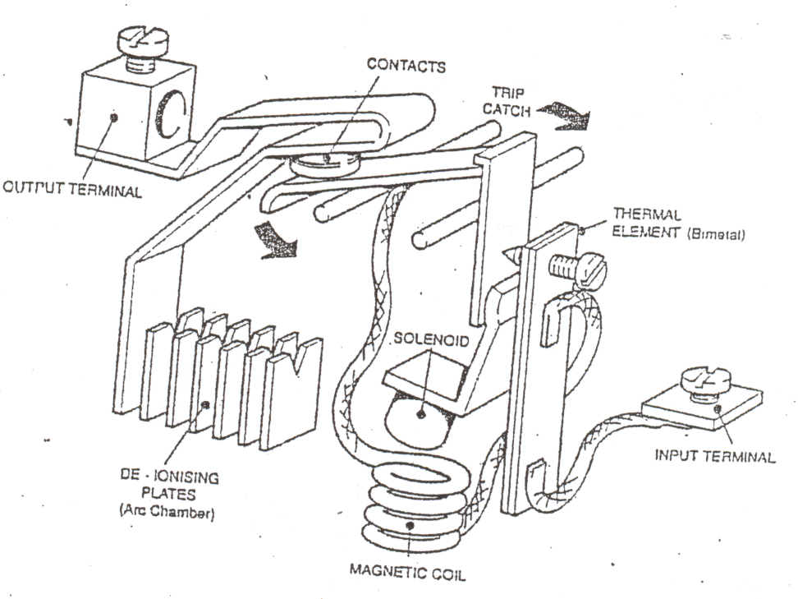
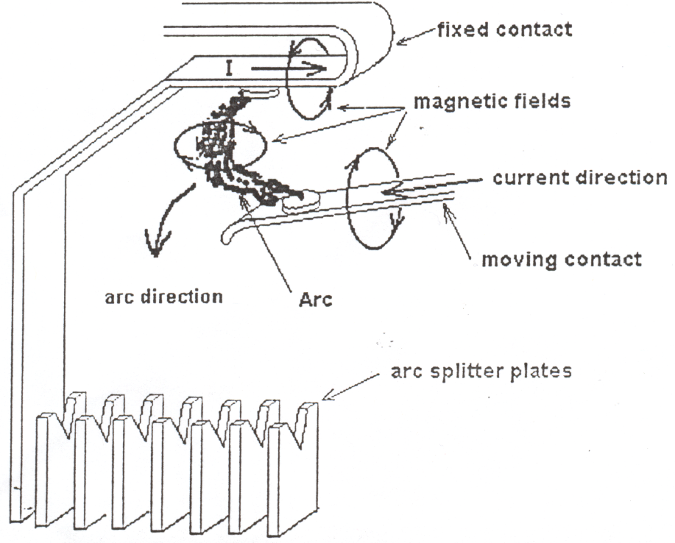
MCB Characteristics
Thermal-Magnetic Tripping
Arc Extinction

Slide 23
Advantages of MCB’s over Fuses
Advantages of MCB’s :
Tripped MCB readily identified even in darkness
Cannot be switched back on while fault exists – trip free mechanism
Enables supply to be restored immediately and easily even by untrained personnel
Accepted as a circuit isolator
Locking devices can be attached for maintenance purposes
Do not normally require replacement
‘Single phasing’ of motors is not an issue
Do not age in service
Tamperproof

Slide 24
Residual Current Devices (RCD’s)
There are two main reasons why RCD’s are used:
  To comply with the ETCI rules for electrical installations.
  To provide additional and a higher level of protection than that given by direct earthing, against electric shock and also against fire risk caused by earth leakage currents. Where fuses and miniature circuit breakers (MCB’s) are the only means of earth fault protection, it is possible for earth fault currents to flow undetected and cause fire risk (or touch voltage problems).
  The use of an RCD will prevent the flow of a sustained leakage current above the sensitivity of the RCD thus greatly reducing shock and fire risk. Red's should disconnect all live conductors in the protected circuits in the event of earth leakage current flowing.

Slide 25
Residual Current Devices (RCD’s)
Terms associated with RCD’s:
  • RCCB:
      Residual Current Circuit Breaker used in distribution boards to protect individual or groups of circuits
  • RCBO:
      Residual Circuit Breaker with overcurrent protection. This is a
      combined MCB/RCD and provides overload, short circuit and earth fault protection in one unit
  • SRCD:
      Socket outlet with combined RCD
  • PRCD:
      This is a portable RCD unit with an inbuilt plug top and socket
      outlet

Slide 26
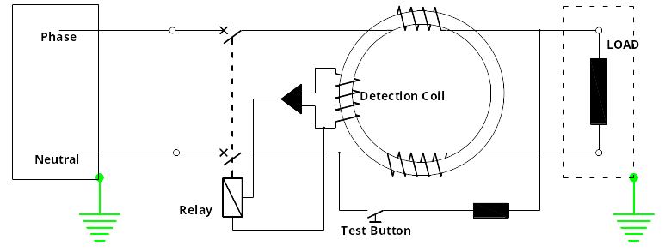
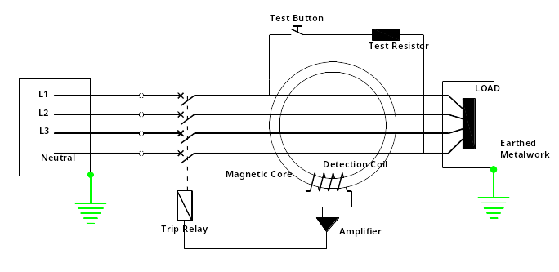
Residual Current Devices (RCD’s)
Single Phase RCD
Three Phase RCD

Slide 27
Residual Current Devices (RCD’s)
Discrimination between RCD’s:
  The time-current characteristic of the device on the supply side shall lie completely above the operating time-current characteristic on the load side
  The rated residual operating current of the device located on the supply side shall be higher than that of the device on the load side
  Selective operation may also be achieved by means of time-delay devices

Slide 28
Residual Current Devices (RCD’s)
Nuisance Tripping:
  Sudden surge of overcurrent
  Voltage spikes/transients
  Inbuilt electronic circuit to protect against such tripping.

Slide 29
Planning Main Switch Boards
The following information is recommended when determining the size and layout of equipment to be used in a main switchboard:
  Schedule of all loads (Max demand per phase)
  Phase balancing of single phase loads
  Application of diversity
  Single line block diagram is required
  Current rating of each item of equipment is included on the block diagram
  Scaled drawing of the proposed switchboard should be prepared

Slide 30

Planning Main Switch Boards
Diversity is applied in an installation when determining the values of load current that are likely to be used.
Diversity is based on assumption that all of the connected load current will not be used simultaneously.
  E.g. thermostatically controlled devises/equipment and time switch controlled loads are unlikely to demand full loads at all times.
When determining the current ratings of switchgear diversity can be applied, which will enable a savings to be made in the sizes of cables and in the current ratings of the switchgear. This saves on both cost and spaces
Diversity is based on the relationship, therefore, between the total load current that is available and the assumed load current demand of an installation.
Table A31-A Annex 31 A in the ETC/Riles and Table J1 of the IEE Guidance Notes on the Selection and Erection of Main Switchgear (more comprehensive guidance)

